Slide 1
Markov Logic Network
Hung-yi Lee
Notes:
Continuous
Soft logic

Slide 2
Markov Logic Network
Markov Logic Network
Undirected Graph
Graphical Model
Structured Learning

Slide 3
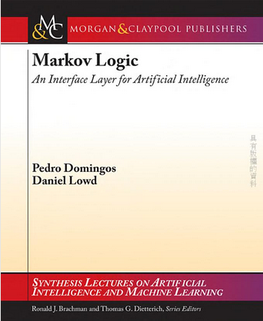
Textbook
Domingos, Pedro, and Daniel Lowd. "Markov logic: An interface layer for artificial intelligence." Synthesis Lectures on Artificial Intelligence and Machine Learning 3.1 (2009): 1-155.
Notes:
Toolkit
Tuffy: http://i.stanford.edu/hazy/hazy/tuffy/
alchemy.cs.washington.edu
Open-source software including:
Full first-order logic syntax
Inference (MAP and conditional probabilities)
Weight learning (generative and discriminative)
Structure learning
Programming language features

Slide 4
More Reference
Course:
http://homes.cs.washington.edu/~pedrod/803/
Toolkit:
Alchemy: http://alchemy.cs.washington.edu/
Tuffy: http://i.stanford.edu/hazy/hazy/tuffy/
Notes:
KK [ˋælkəmɪ] 鍊金術 University of Washington
傑利的表弟吧~名字叫作Tuffy~翻中應是羅夫
https://www.youtube.com/watch?v=Q1IpE9_pBu4&feature=plcp

Slide 5
Machines use logic as humans?
This is also a structured learning problem.
Evaluation:
Evaluate how logical a possibility is based on the knowledge base
Using as graphical model (?)
Inference:
Evaluate all possibilities and find the most logical one
Training:
Learn the knowledge base
Notes:
http://i.stanford.edu/hazy/papers/tuffy-vldb2011-slides.pdf
Ｔｏｎｉｇｈｔ：
Logic+world
Evaluation graphical
As repgression
learning
Inference:
二：slide
三：lifted
Training: 四 morning
More learning: 10
一 night
二 night
三 night

Slide 6


Terminology
Knowledge base: a set of Formulas
Formula: $P⇒Q$, $P⇔Q$ …
Conjunction of predicates by logic operation
Logic operation: ~, $∧$, $∨$, $⇒$, $⟺$
Predicate: P, Q
Predicate is a function
Input: one or several objects
Output: True or False
Predicate:
Formula:
姓宇智波 (x)
有寫輪眼(x)
姓宇智波(x) $⇒$有寫輪眼(x)

Slide 7
Terminology
Grounding: Replace the variables in the predicates with all possible constant
Example:
Predicate: 宅(x)
x: is a variable which can be any person
Person = {Anna, Bob}
constant
Grounding
宅(Anna)
宅(Bob)
宅(x)
Notes:
World: all the predicates (作出論斷，斷言)
Some of the world is not “logical”
Part of the world is observed

Slide 8
Terminology
World: 一個可能的情況
World: Grounding all the predicates, and assign a truth value to each grounded predicate
Predicate: 是朋友(x,y), 宅(x), 做研究(y)
Person: {A, B, C}
是朋友(A,B)
是朋友(B,C)
是朋友(A,C)
宅(A)
宅(B)
宅(C)
做研究(A)
做研究(B)
做研究(C)
=T
=T
=T
=T
=T
=T
=T
=T
=T
是朋友(A,B)
是朋友(B,C)
是朋友(A,C)
宅(A)
宅(B)
宅(C)
做研究(A)
做研究(B)
做研究(C)
=F
=F
=F
=F
=F
=F
=F
=F
=F
U
U’
Notes:
World: all the predicates
Some of the world is not “logical”
Part of the world is observed

Slide 9

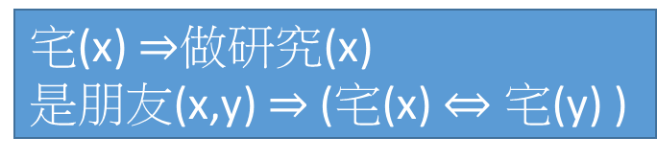
Evaluation – Logic
Evaluating a world is logic or not given a knowledge base
宅(x) $⇒$做研究(x)
是朋友(x,y) $⇒$ (宅(x) $⇔$ 宅(y) )
Knowledge Base L:
Person:
{A, B}
是朋友(A,B)
宅(A)
宅(B)
做研究(A)
做研究(B)
=T
=T
=T
=T
=T
是朋友(A,B)
宅(A)
宅(B)
做研究(A)
做研究(B)
=T
=T
=F
=T
=T
World U:
World U’:
L(U) = T
L(U’) = F

Slide 10
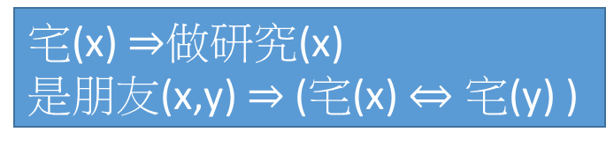
Inference - Logic
Knowledge Base L:
Evidence:
宅(x) $⇒$做研究(x)
是朋友(x,y) $⇒$ (宅(x) $⇔$ 宅(y) )
是朋友(A,B) =T
宅(A)=T
World U:
X
(evidence)
是朋友(A,B)
宅(A)
宅(B)
做研究(A)
做研究(B)
=T
=T
=?
=?
=?
是朋友(A,B)
宅(A)
宅(B)
做研究(A)
做研究(B)
=T
=T
=T
=T
=T
Check the 8 possible worlds
By L(U)
Y
(to be inferred)
There is only one logical world.

Slide 11
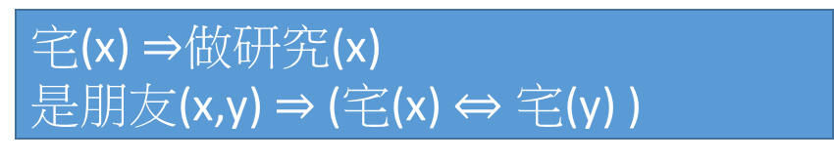
Evaluation – Soft Logic
The real world is complex.
Each formula is assigned a weight representing confidence score.
When a world violates a formula, It becomes less probable, but not impossible
L(U) = logical or not
L(U) = how logical it is
1.5
1.1
宅(x) $⇒$做研究(x)
是朋友(x,y) $⇒$ (宅(x) $⇔$ 宅(y) )
Notes:
永遠都會有不科學的事發生

Slide 12



Evaluation – Soft Logic
$L\left(U\right)$: How logical a world U is given knowledge base L
Probability point of view:
Sum over all formulas in knowledge base
$$L\left(U\right)=\sum_{i}{w_{i}n_{i}\left(U\right)}$$
No. of times formula i is true
Weight of formula i
$$P\left(U\right)=\frac{e^{L\left(U\right)}}{\sum_{U^{′}}{e^{L\left(U^{′}\right)}}}$$
(The probability that the world U appears.)

Slide 13




Inference – Soft Logic
Given a world U = {X, Y}, X is known, find the most possible Y
$$\tilde{Y}=arg\max_{Y}{L\left(X,Y\right)}$$
是朋友(A,B)
宅(A)
宅(B)
做研究(A)
做研究(B)
=T
=T
=?
=?
=?
X
$$=arg\max_{Y}{\sum_{i}{w_{i}n_{i}\left(X,Y\right)}}$$
Y
$$\tilde{Y}=arg\max_{Y}{P\left(Y|X\right)}$$
You can use Gibbs sampling if you do not know how to solve the problem.
$$=arg\max_{Y}{\frac{e^{L\left(X,Y\right)}}{\sum_{Y^{′}}{e^{L\left(X,Y^{′}\right)}}}}$$
Notes:
This is just the weighted MaxSAT problem
Use weighted SAT solver (e.g., MaxWalkSAT [Kautz et al., 1997]

Slide 14
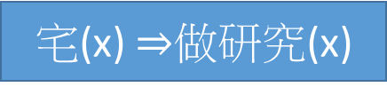
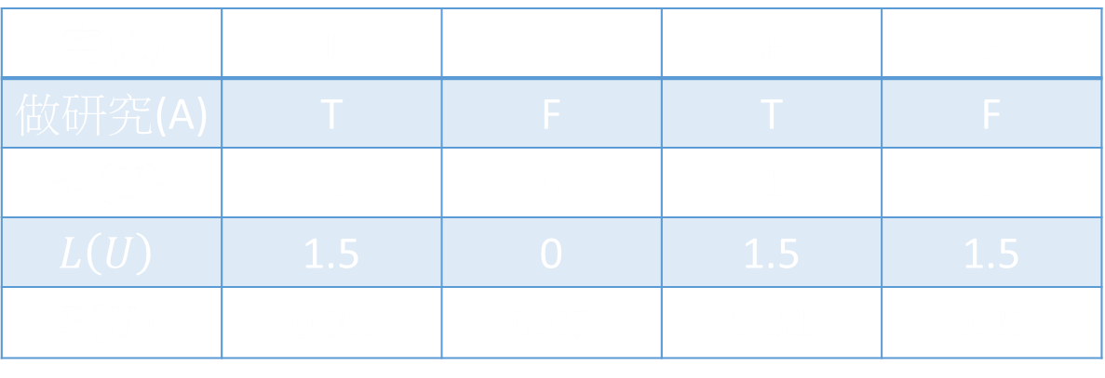


Example
If we observe that 宅(A) = T
$$w_{1}$$
1.5
宅(x) $⇒$做研究(x)
$$f_{1}$$
P( 做研究(A) = T ) = 0.82
Person = {Anna}
P( 做研究(A) = F ) = 0.18
宅(A) | T | T | F | F
做研究(A) | T | F | T | F
$$n_{1}\left(U\right)$$ | 1 | 0 | 1 | 1
$$L\left(U\right)$$ | 1.5 | 0 | 1.5 | 1.5
$$P\left(U\right)$$ | 0.31 | 0.07 | 0.31 | 0.31
Notes:
Only Anna (A) in the world

Slide 15
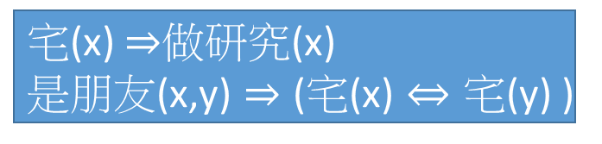

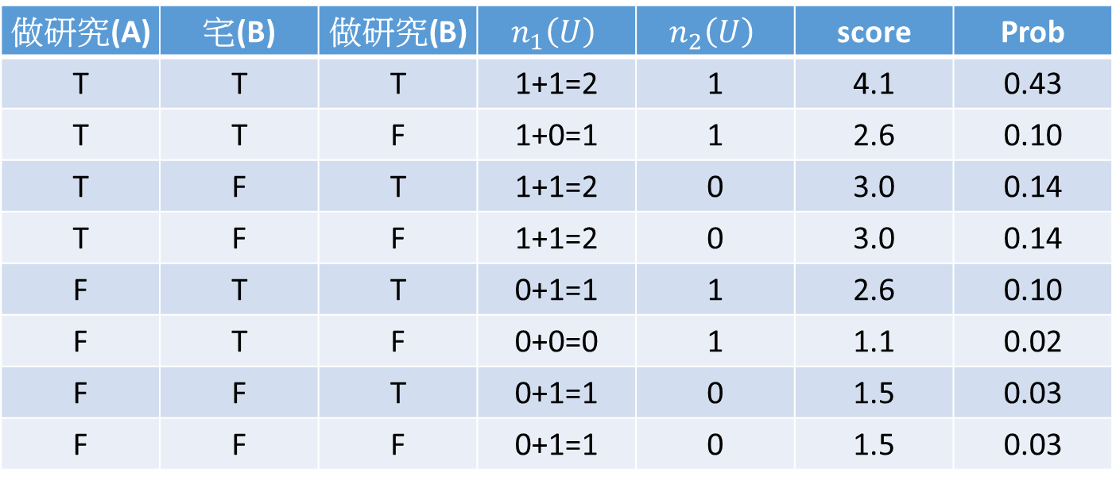



$$f_{1}$$
Evidence:
$$w_{1}$$
1.5
1.1
宅(x) $⇒$做研究(x)
是朋友(x,y) $⇒$ (宅(x) $⇔$ 宅(y) )
$$w_{2}$$
$$f_{2}$$
是朋友(A,B) =T
宅(A)=T
Person = {Anna, Bob}
做研究(A) | 宅(B) | 做研究(B) | $$n_{1}\left(U\right)$$ | $$n_{2}\left(U\right)$$ | score | Prob
T | T | T | 1+1=2 | 1 | 4.1 | 0.43
T | T | F | 1+0=1 | 1 | 2.6 | 0.10
T | F | T | 1+1=2 | 0 | 3.0 | 0.14
T | F | F | 1+1=2 | 0 | 3.0 | 0.14
F | T | T | 0+1=1 | 1 | 2.6 | 0.10
F | T | F | 0+0=0 | 1 | 1.1 | 0.02
F | F | T | 0+1=1 | 0 | 1.5 | 0.03
F | F | F | 0+1=1 | 0 | 1.5 | 0.03
Q: Bob 是否喜歡做研究?
A: 70% 的機率 Bob 喜歡做研究

Slide 16










Graphical Model
1.5
1.1
宅(x) $⇒$做研究(x)
是朋友(x,y) $⇒$ (宅(x) $⇔$ 宅(y) )
$$f_{1}$$
Each ground predicate is a node.
$$f_{2}$$
The formulas are Factors.
是朋友(A,B)
T
$f_{2}\left( \text{是朋友}\text{(}\text{A}\text{,}\text{B}\right) ,\text{宅}\text{(}\text{A}\text{)}$ , 宅(B) )
$$f_{2}$$
宅(A)
T
$$+$$
$f_{1} (\text{宅}\text{(}\text{A}\text{)}$ , 做研究(A) )
宅(B)
$$f_{1}$$
$$+$$
做研究(A)
$f_{1}\text{( }\text{宅}\text{(}\text{B}\text{) ,} \text{做研究}\text{(}\text{B}\text{)}$)
做研究(B)
$$f_{1}$$
$$=$$
$$L\left(U\right)$$

Slide 17
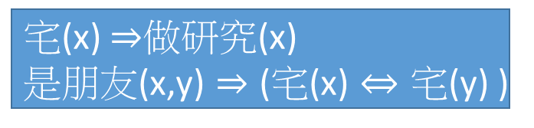











$$w_{1}$$
1.5
1.1
宅(x) $⇒$做研究(x)
是朋友(x,y) $⇒$ (宅(x) $⇔$ 宅(y) )
$$f_{1}$$
$$w_{2}$$
$$f_{2}$$
$$f_{1} (\text{宅}\text{(}\text{x}\text{) , }\text{做研究}\text{(}\text{x}\text{) ) =}\left\{\begin{matrix}w_{1} \\ 0\end{matrix}\right.$$
$\left(\text{宅}\text{(}\text{x}\text{) }⇒\text{做研究}\text{(}\text{x}\text{)}\right)$ is true
$$otherwise$$
是朋友(A,B)
T
$f_{2}\left( \text{是朋友}\text{(}\text{A}\text{,}\text{B}\right) ,\text{宅}\text{(}\text{A}\text{)}$ , 宅(B) )
$$f_{2}$$
宅(A)
T
$$+$$
$f_{1} (\text{宅}\text{(}\text{A}\text{)}$ , 做研究(A) )
宅(B)
$$f_{1}$$
$${=w}_{1}$$
$$=0$$
$$+$$
做研究(A)
T
F
$f_{1}\text{( }\text{宅}\text{(}\text{B}\text{) ,} \text{做研究}\text{(}\text{B}\text{)}$)
做研究(B)
$$f_{1}$$
$$=$$
$$L\left(U\right)$$
Notes:
How about the lower f1 …

Slide 18





$$w_{1}$$
1.5
1.1
宅(x) $⇒$做研究(x)
是朋友(x,y) $⇒$ (宅(x) $⇔$ 宅(y) )
$$f_{1}$$
$$w_{2}$$
$$f_{2}$$
$\left(\text{是朋友}\text{(}\text{x}\text{,}\text{y}\text{) }⇒ \text{(}\text{宅}\text{(}\text{x}\text{) }⇔\text{ 宅}\text{(}\text{y}\text{) ) }\right)$ is true
$$f_{2}\left( \text{是朋友}\text{(}\text{A}\text{,}\text{B}\right) ,\text{宅}\text{(}\text{A}\text{) , }\text{宅}\text{(}\text{B}\text{) )=}\left\{\begin{matrix}w_{2} \\ 0\end{matrix}\right.$$
$$otherwise$$
是朋友(A,B)
T
$f_{2}\left( \text{是朋友}\text{(}\text{A}\text{,}\text{B}\right) ,\text{宅}\text{(}\text{A}\text{)}$ , 宅(B) )
$$f_{2}$$
$${=w}_{2}$$
$$=0$$
宅(A)
T
$$+$$
$f_{1} (\text{宅}\text{(}\text{A}\text{)}$ , 做研究(A) )
宅(B)
T
F
$$f_{1}$$
$$+$$
做研究(A)
$f_{1}\text{( }\text{宅}\text{(}\text{B}\text{) ,} \text{做研究}\text{(}\text{B}\text{)}$)
做研究(B)
$$f_{1}$$
$$=$$
$$L\left(U\right)$$

Slide 19



Graphical Model
Factor Graph
Markov Random Field
是朋友(A,B)
是朋友(A,B)
$$f_{2}$$
宅(A)
宅(A)
宅(B)
宅(B)
$$f_{1}$$
做研究(A)
做研究(B)
$$f_{1}$$
做研究(A)
做研究(B)
This is why the model is named Markov Logic Network

Slide 20





Learning
Given a set of formulas {$F_{1}⋯F_{i}⋯F_{N}$} and world U, assign weights {$w_{1}⋯w_{i}⋯w_{N}$} for each formulas
Maximizing the likelihood of world $P\left(U\right)$
$$P\left(U\right)=\frac{e^{L\left(U\right)}}{\sum_{U^{′}}{e^{L\left(U^{′}\right)}}}$$
$$L\left(U\right)=\sum_{i}{w_{i}n_{i}\left(U\right)}$$
$$logP\left(U\right)=L\left(U\right)−log\sum_{U^{′}}{e^{L\left(U^{′}\right)}}$$
$$w_{i}←w_{i}+η\frac{∂logP\left(U\right)}{∂w_{i}}$$
Gradient ascent:

Slide 21
Learning
If there is some missing data in the world
U
是朋友(A,B)
是朋友(B,C)
是朋友(A,C)
宅(A)
宅(B)
宅(C)
做研究(A)
做研究(B)
做研究(C)
=T
=T
=T
=T
=T
=T
=T
=T
=T
是朋友(A,B)
是朋友(B,C)
是朋友(A,C)
宅(A)
宅(B)
宅(C)
做研究(A)
做研究(B)
做研究(C)
=T
=?
=T
=?
=T
=?
=T
=?
=T
Observed
world
Hidden world
X
H

Slide 22



Learning
If there is some missing data in the world
X: observed part of the world, H: missing part
$$P\left(X\right)=\sum_{H^{′}}{P\left(X,H^{′}\right)}$$
Everything you don’t observe can happen
$$\frac{∂logP\left(X\right)}{∂w_{i}}=\sum_{H^{′}}{P\left(X,H^{′}\right)n_{i}\left(X,H^{′}\right)}$$
$$−\sum_{X^{′},H^{′}}{P\left(X^{′},H^{′}\right)n_{i}\left(X^{′},H^{′}\right)}$$

Slide 23
Learning the Correctness - UW-CSE database
Available: http://www.cs.washington.edu/ai/mln/database.html
1158 constants: person, course, paper title ……
22 predicates: Professor(x), AdvicedBy(x,y)
4M grounding predicates, 3k are true
94 hand-crafted formulas are given
Learn the weight
The formulas with the highest weights
(course c is taught by x) => (x is a professor) 3.5
(x is advised by y) => (y is the co-author of the paper x published) 3.1
Notes:
University of Washington Department of Computer Science and Engineering.

Slide 24
Outlook
Markov Logic Network can learn more than just weights
It can ……
Discover the knowledge
Discover the predicates
Transfer Learning
Unsupervised Learning
Markov Logic Network can be used in general supervised learning like classification
Not especially powerful, but interpretable

